Slide 1
Getting Started in Office 365 with the Microsoft Graph API

Slide 2
Intro to the Microsoft Graph API
</>

Slide 3
Agenda
Intro to the Microsoft Graph API
Getting started
SDKs and Code Samples
Resources

Slide 4
1
Intro to the Microsoft Graph API

Slide 5
Developer vision
USERS
DATA
HTML
Notes:
Our Office 365 developer vision focuses on the Users’ experience and their data. As a developer you can bring your applications into their user experience. With over 1.2+ billion users of Office Worldwide, this is a huge opportunity to provide a window into your applications. As well as being able to connect into their data and add intelligence to your applications. There are currently 850 million events created a month and a total of 470Pb+ of data stored in the service that can add value to for our Users’.

Slide 6
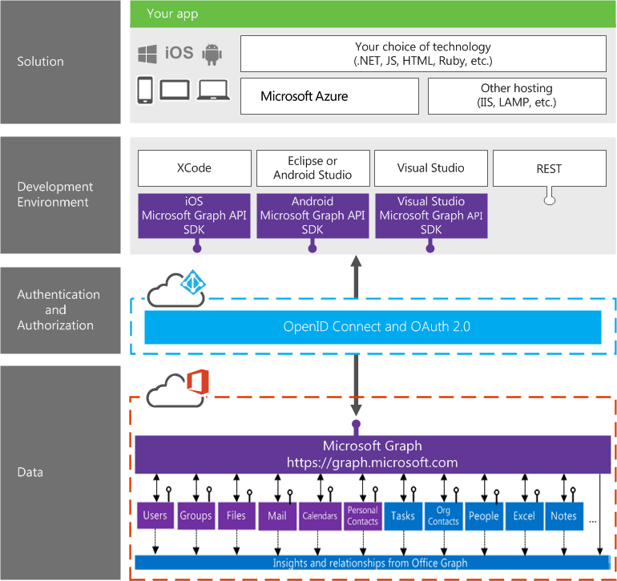
Building integration with Office 365

Slide 7

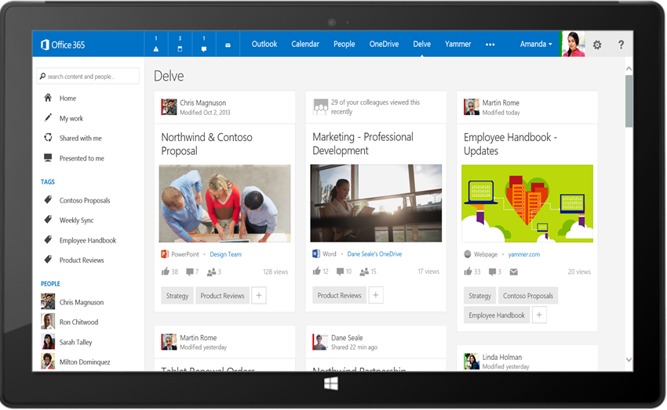
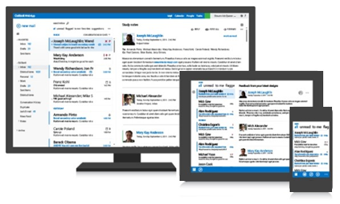
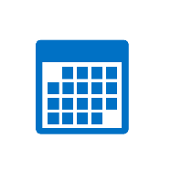



Microsoft Graph API
Your App
https://graph.microsoft.com/
USERS
GROUPS
FILES
MAIL
CALENDAR
TASKS
Insights and relationships from Office Graph

Slide 8
Microsoft Graph, gateway to Office 365
Single resource that proxies multiple Microsoft services
Allows for easy traversal of objects and relationships
Simplifies token acquisition and management
Eliminates the need to traditional discovery (using “me” and “myorganization”)

Slide 9
Office 365 direct API Endpoints
Direct API endpoints for all the Office 365 Services may also be invoked
Outlook, OneDrive, OneNote, etc.
Direct endpoints have new functionality before it is exposed via the Graph API
Examples:
Outlook web hooks
Time zone on calendar

Slide 10
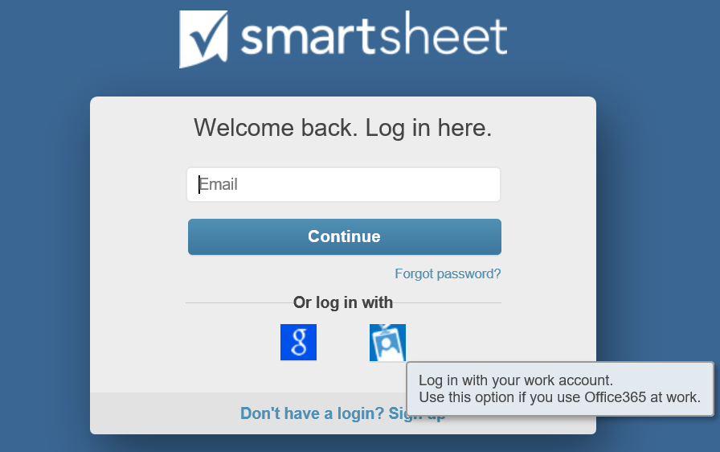
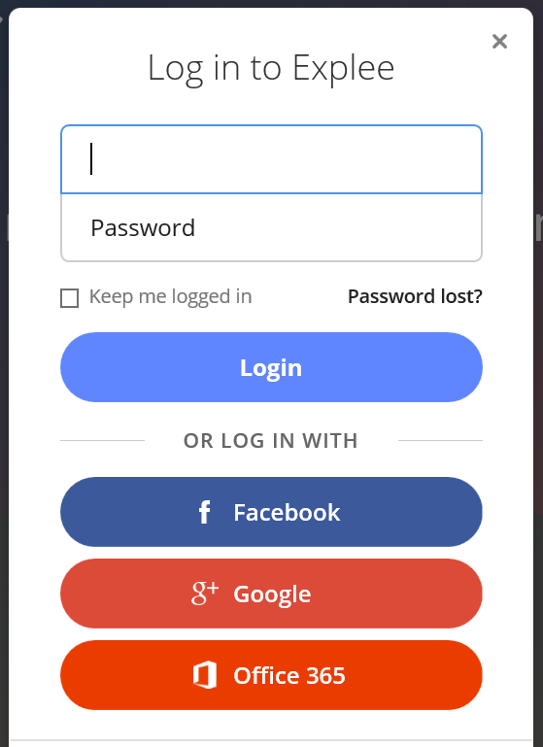
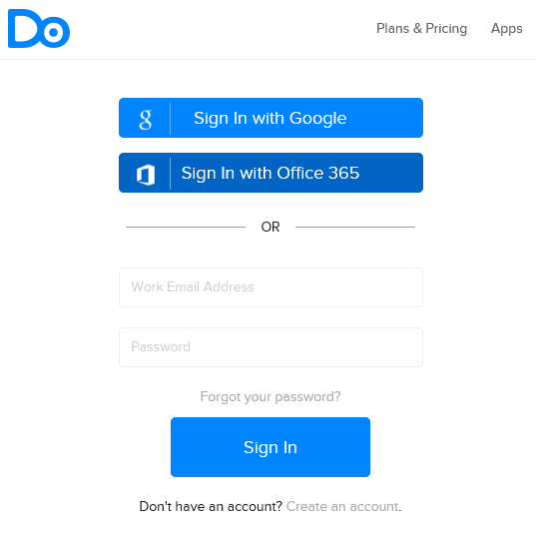
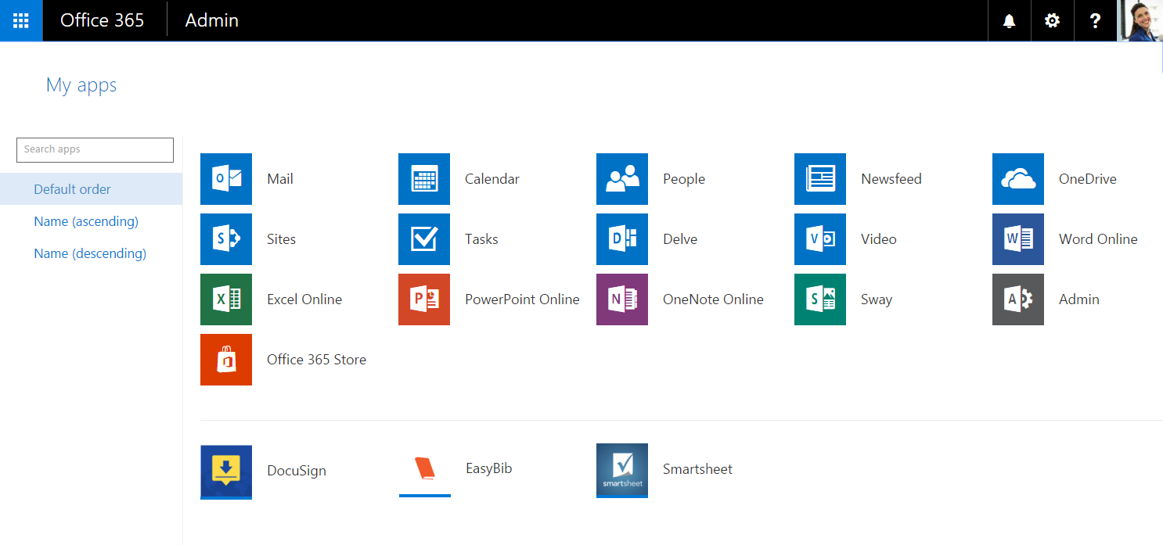
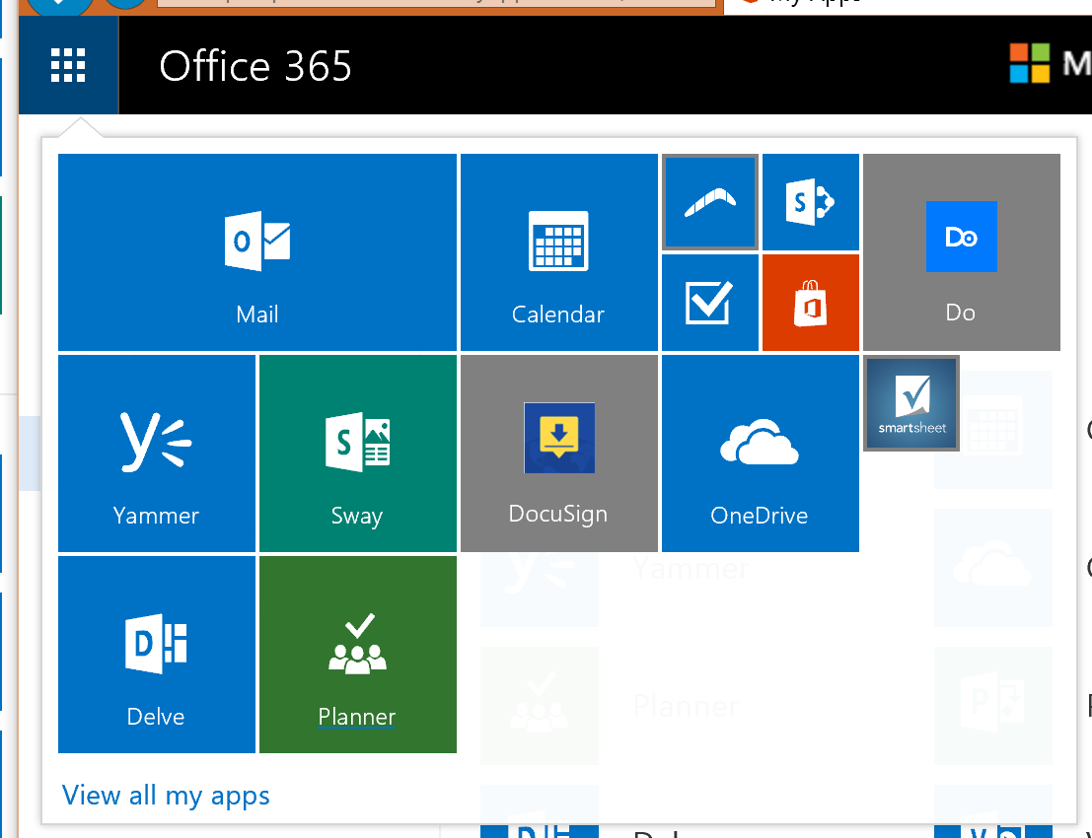
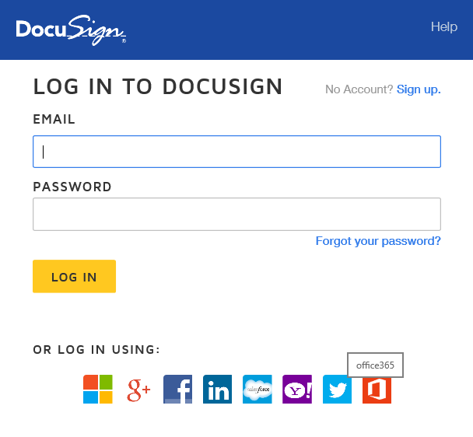
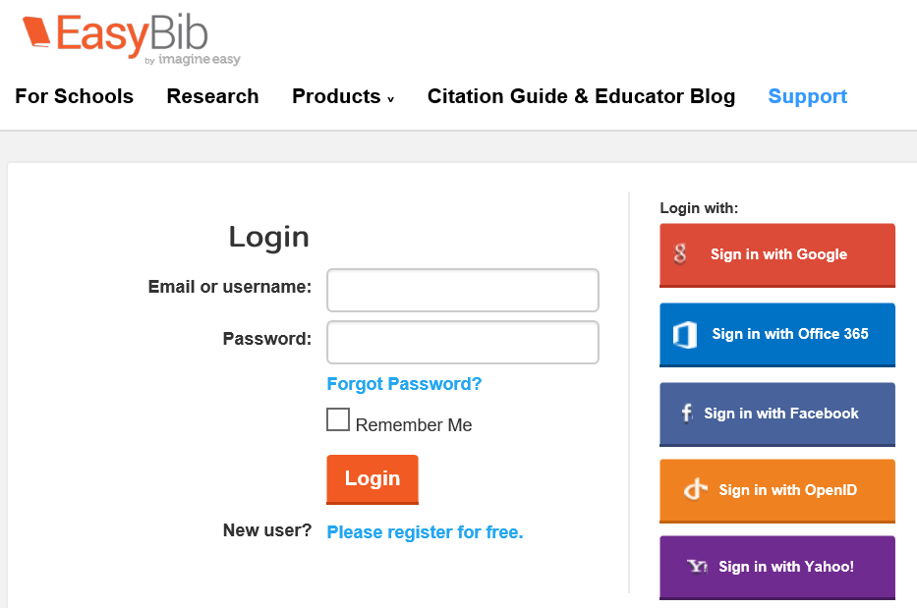
Office 365 connected apps

Slide 11
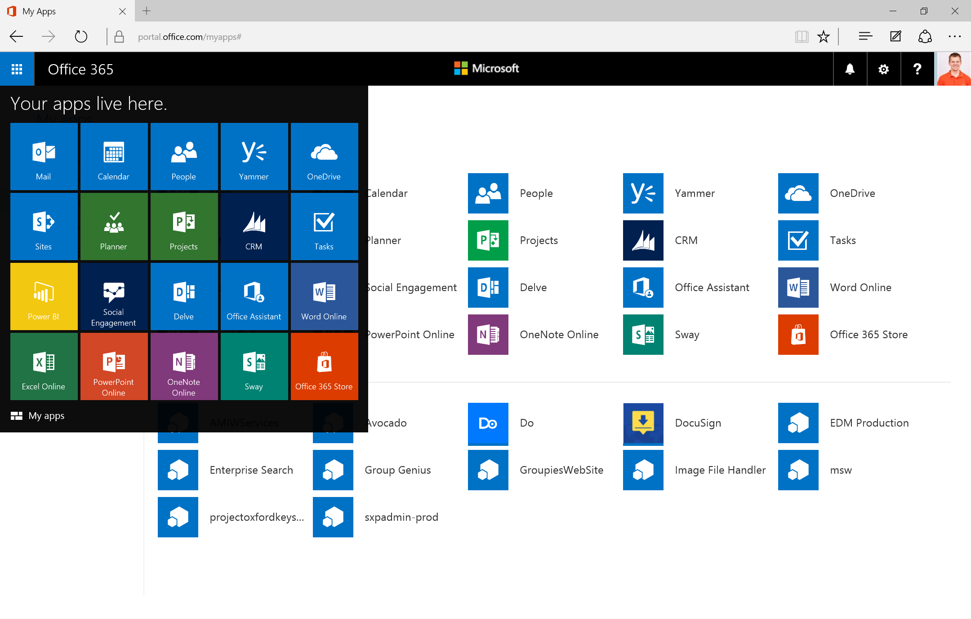
Single authentication flow for Office 365
Sign users in using OpenID Connect
Azure AD and Office 365 services
Supports MFA and federated user sign-in
Device apps, web sites, SPAs, and service apps
Pin apps to Office 365 app launcher from My apps

Slide 12
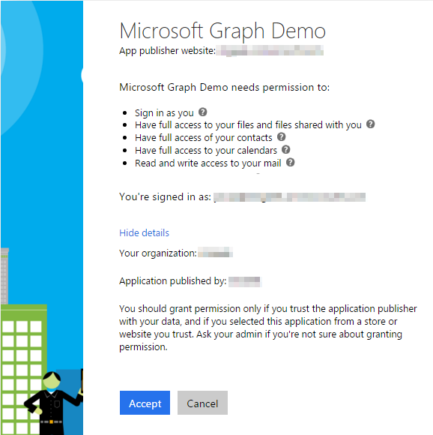
Common consent
Single auth flow for accessing all O365 services
Admin and end-user consent
Secure protocol
OpenID Connect and OAuth 2.0
No capturing user credentials
Fine-grained access scopes
Long-term access through refresh tokens

Slide 13
Authentication Options
Azure AD only
Separate auth flow supports Azure AD accounts only
Azure AD and Microsoft Accounts (Preview)
Converged auth flow supports Azure AD accounts and Microsoft accounts (LiveID - hotmail.com, etc.)

Slide 14
Microsoft Account + Azure AD
Many apps want to sign users in from both Microsoft account and Azure AD
Now in preview:
Single endpoint, OpenID Connect and OAuth 2.0
Single SDK
Single end user sign in experience
Single app registration experience
Works with Microsoft Graph
Single API endpoint, business and consumer data

Slide 15
Integrating with Office 365
Your App
https://graph.microsoft.com/
USERS
GROUPS
FILES
MAIL
CALENDAR
TASKS
Insights and relationships from Office Graph

Slide 16
Demo Do.com Store Graph Visualizer Graph Explorer
Notes:
https://graph.microsoft.com/v1.0/me
https://graph.microsoft.com/v1.0/me/manager
https://graph.microsoft.com/v1.0/me/messages
https://graph.microsoft.com/v1.0/me/events
https://graph.microsoft.com/v1.0/me/files
https://graph.microsoft.com/v1.0/me/files/{id}/createdbyuser/manager
https://graph.microsoft.com/v1.0/me/files/{id}/createdbyuser/manager/?$whatif
https://graph.microsoft.com/v1.0/myorganization/users
https://graph.microsoft.com/v1.0/myorganization/groups
https://graph.microsoft.com/v1.0/me/joinedgroups
https://graph.microsoft.com/v1.0/me/joinedgroups/{id}/files
https://graph.microsoft.com/v1.0/me/joinedgroups/{id}/conversations

Slide 17
2
Getting started

Slide 18

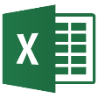
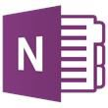
Microsoft Graph
trendingAround
Shared with me
createdBy
CONVERSATIONS
public
manager
USER
workingWith
directReports
EVENTS
trendingAround
https://graph.microsoft.com/
modifiedBy
TASKS
FILES
memberOf
workingWith
TASKS
GROUPS
createdBy
NOTES
NOTES
MESSAGES
FILES

Slide 19
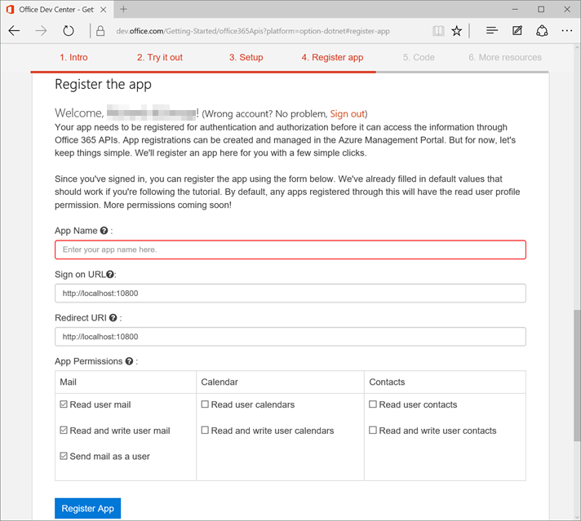
Register App from dev.office.com

Slide 20
Demo Documentation App registration
Notes:
Documentation - https://graph.microsoft.com
App registration
Show app registration from http://dev.office.com/getting-started/office365apis and through azure management portal

Slide 21
3
SDKS and Code samples

Slide 22
Demo SDKs Code samples
Notes:
SDKs
Code samples - Github

Slide 23
4
Resources

Slide 24

Resources
Documentation, samples and more:
https://graph.microsoft.com/
Stack overflow:
[MicrosoftGraph] and [Office365]
Twitter:
#MicrosoftGraph and #Office365dev

Slide 25
Further reading…
Getting Started with APIs
Microsoft Graph API Code Samples
Microsoft Graph API Training videos & hands on labs
Microsoft Graph API documentation

Slide 26
Developer Program
1 YEAR FREE
E-mail Newsletters
Free Developer Subscription
Free Training
Free Tools
Webinars
http://dev.office.com/devprogram

Slide 27


Engage
Office 365 Network
https://www.yammer.com/itpronetwork
Twitter
S
S
t
t
a
a
r
r
t
t
@OfficeDev
Stack overflow
[ms-office]
Channel 9 Dev Show
http://aka.ms/O365DevShow
Podcasts http://dev.office.com/podcasts
Snack Demos
http://aka.ms/o365DevSnackDemos
UserVoice
http://officespdev.uservoice.com/

Slide 28
Session Evaluations Sign in to the Schedule Builder and select ‘My Evaluations’ to complete your Session Evaluations after each session. http://aka.ms/cloud.saopaulo

